Slide 1
Assistive technology
TTS Accessibility Guild
GSA | Technology Transformation Services
Notes:
Robert

Slide 2
Homework
What is the number one thing you would change about each website?
Notes:
Robert

Slide 3
Why does assistive technology matter?
Notes:
Nikki

Slide 4
Looking at the code isn’t enough. We need to actually use the products that we build, in ways that our end users will use them.

Slide 5
That means we want to use assistive technology (AT) to interact with our products, to make sure that everything works the way it should.

Slide 6
This works best as an extension of our manual testing workflows; we’ll run through all of the same scenarios.

Slide 7
Using assistive technology
Notes:
Nikki

Slide 8
1 / Navigate web pages without a mouse.

Slide 9
Keyboard navigation is one of the most important parts of accessibility. Luckily, it’s very easy to test: set aside your mouse (and trackpad) and see whether or not you can still use your product.

Slide 10
You should be particularly watchful for keyboard traps. Keyboard traps are interactions that you can enter with keyboard, but require a mouse to get out of.

Slide 11

Display
Keyboards users can use the entire page and get back to the address bar

Slide 12

Display
Keyboard users get stuck in a loop, unable to navigate to other parts of the page

Slide 13
How to test
Open up a page, and navigate it using your keyboard (tab, arrows, enter, space, and esc).
Navigate through the entire page and use all interactive features. If you get locked into a place where you cannot exit or move on from using just your keyboard, you’ve discovered a keyboard trap!
If you find a keyboard trap, you can reference WCAG 2.1.2: No Keyboard Trap in your bug report.

Slide 14
2 / Scale up text to 200% and make sure that nothing breaks.
Notes:
Robert

Slide 15
Sometimes people need text to be bigger so that they can read it properly. Your design should account for that!

Slide 16
There’s no perfect test, but turning zoom up to 200% is a really solid test.

Slide 17
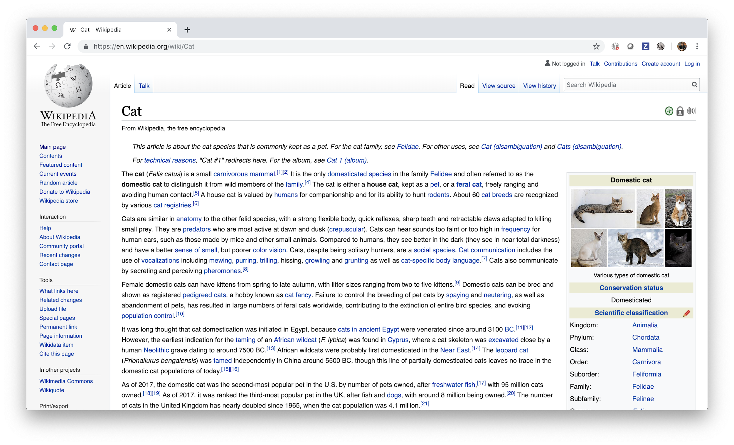
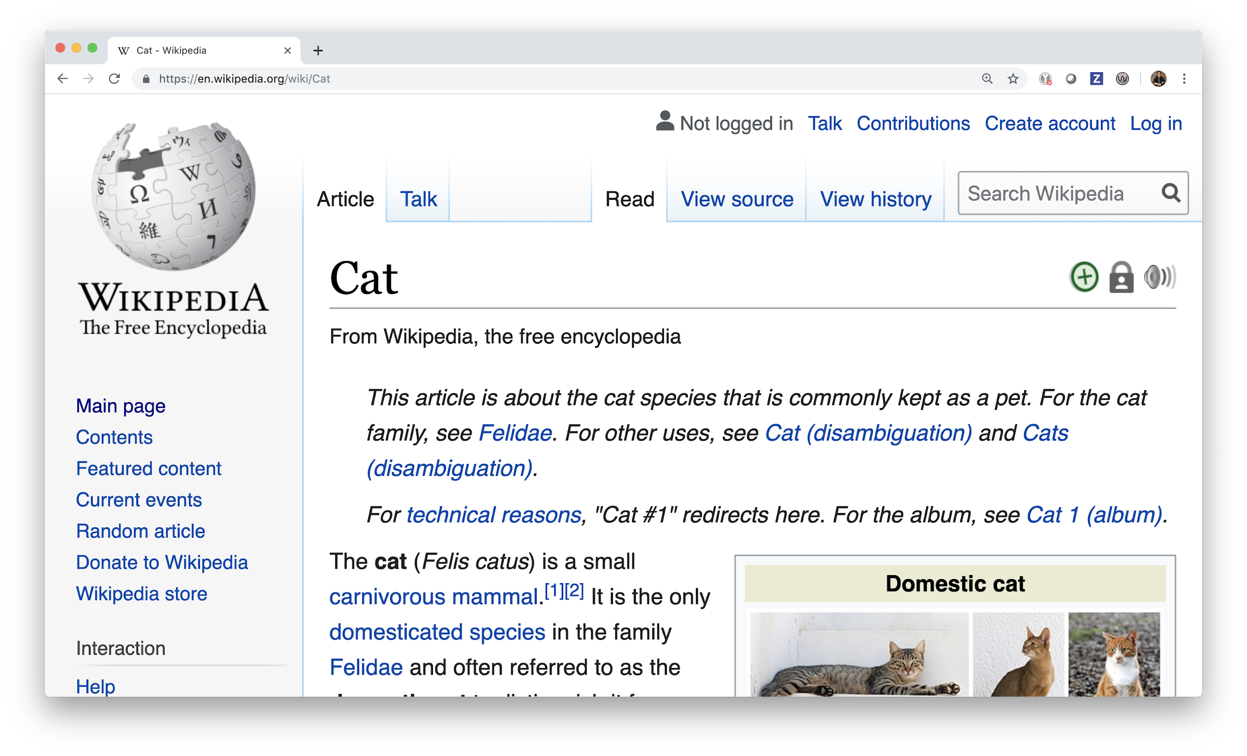
Zooming in reflows the web page, so all of the content is still available
100% zoom
200% zoom

Slide 18
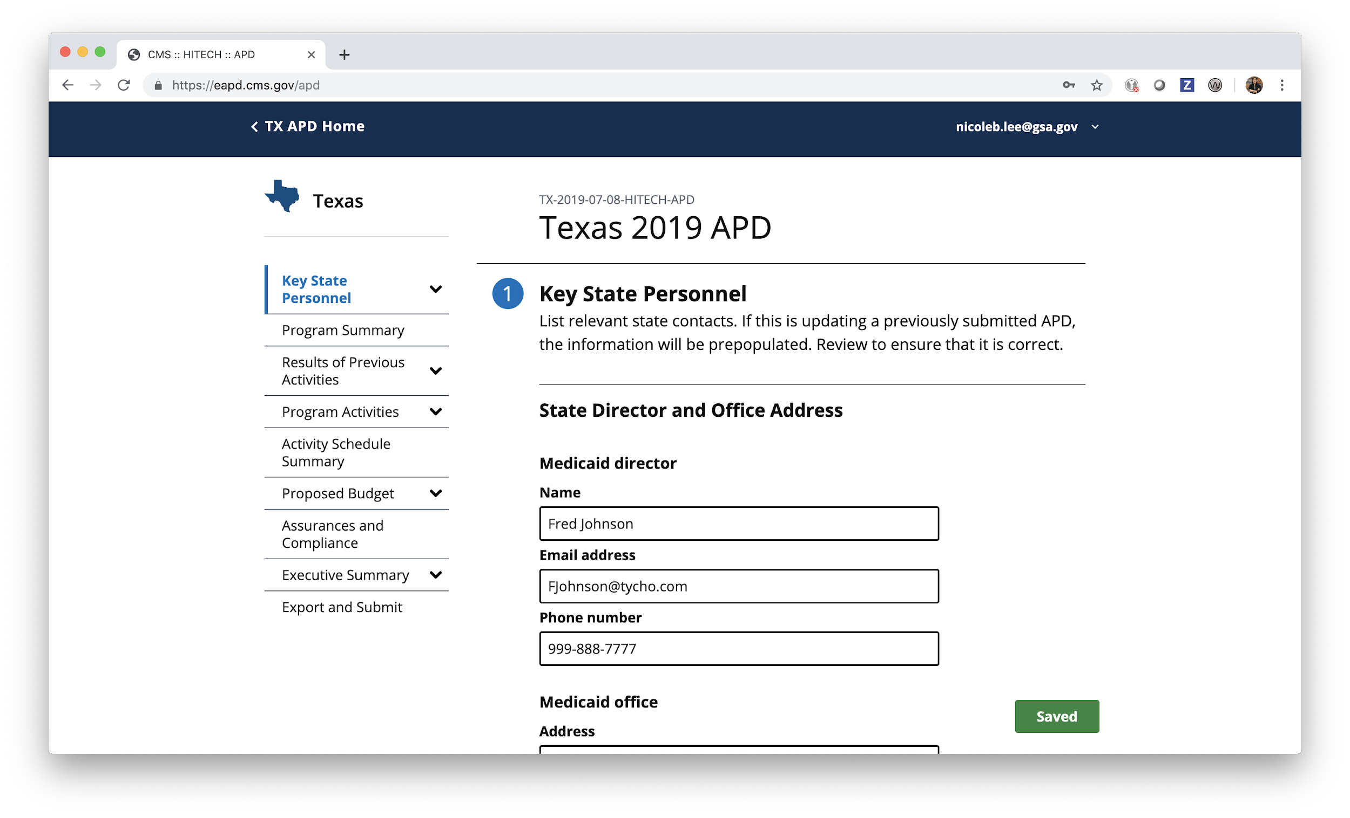
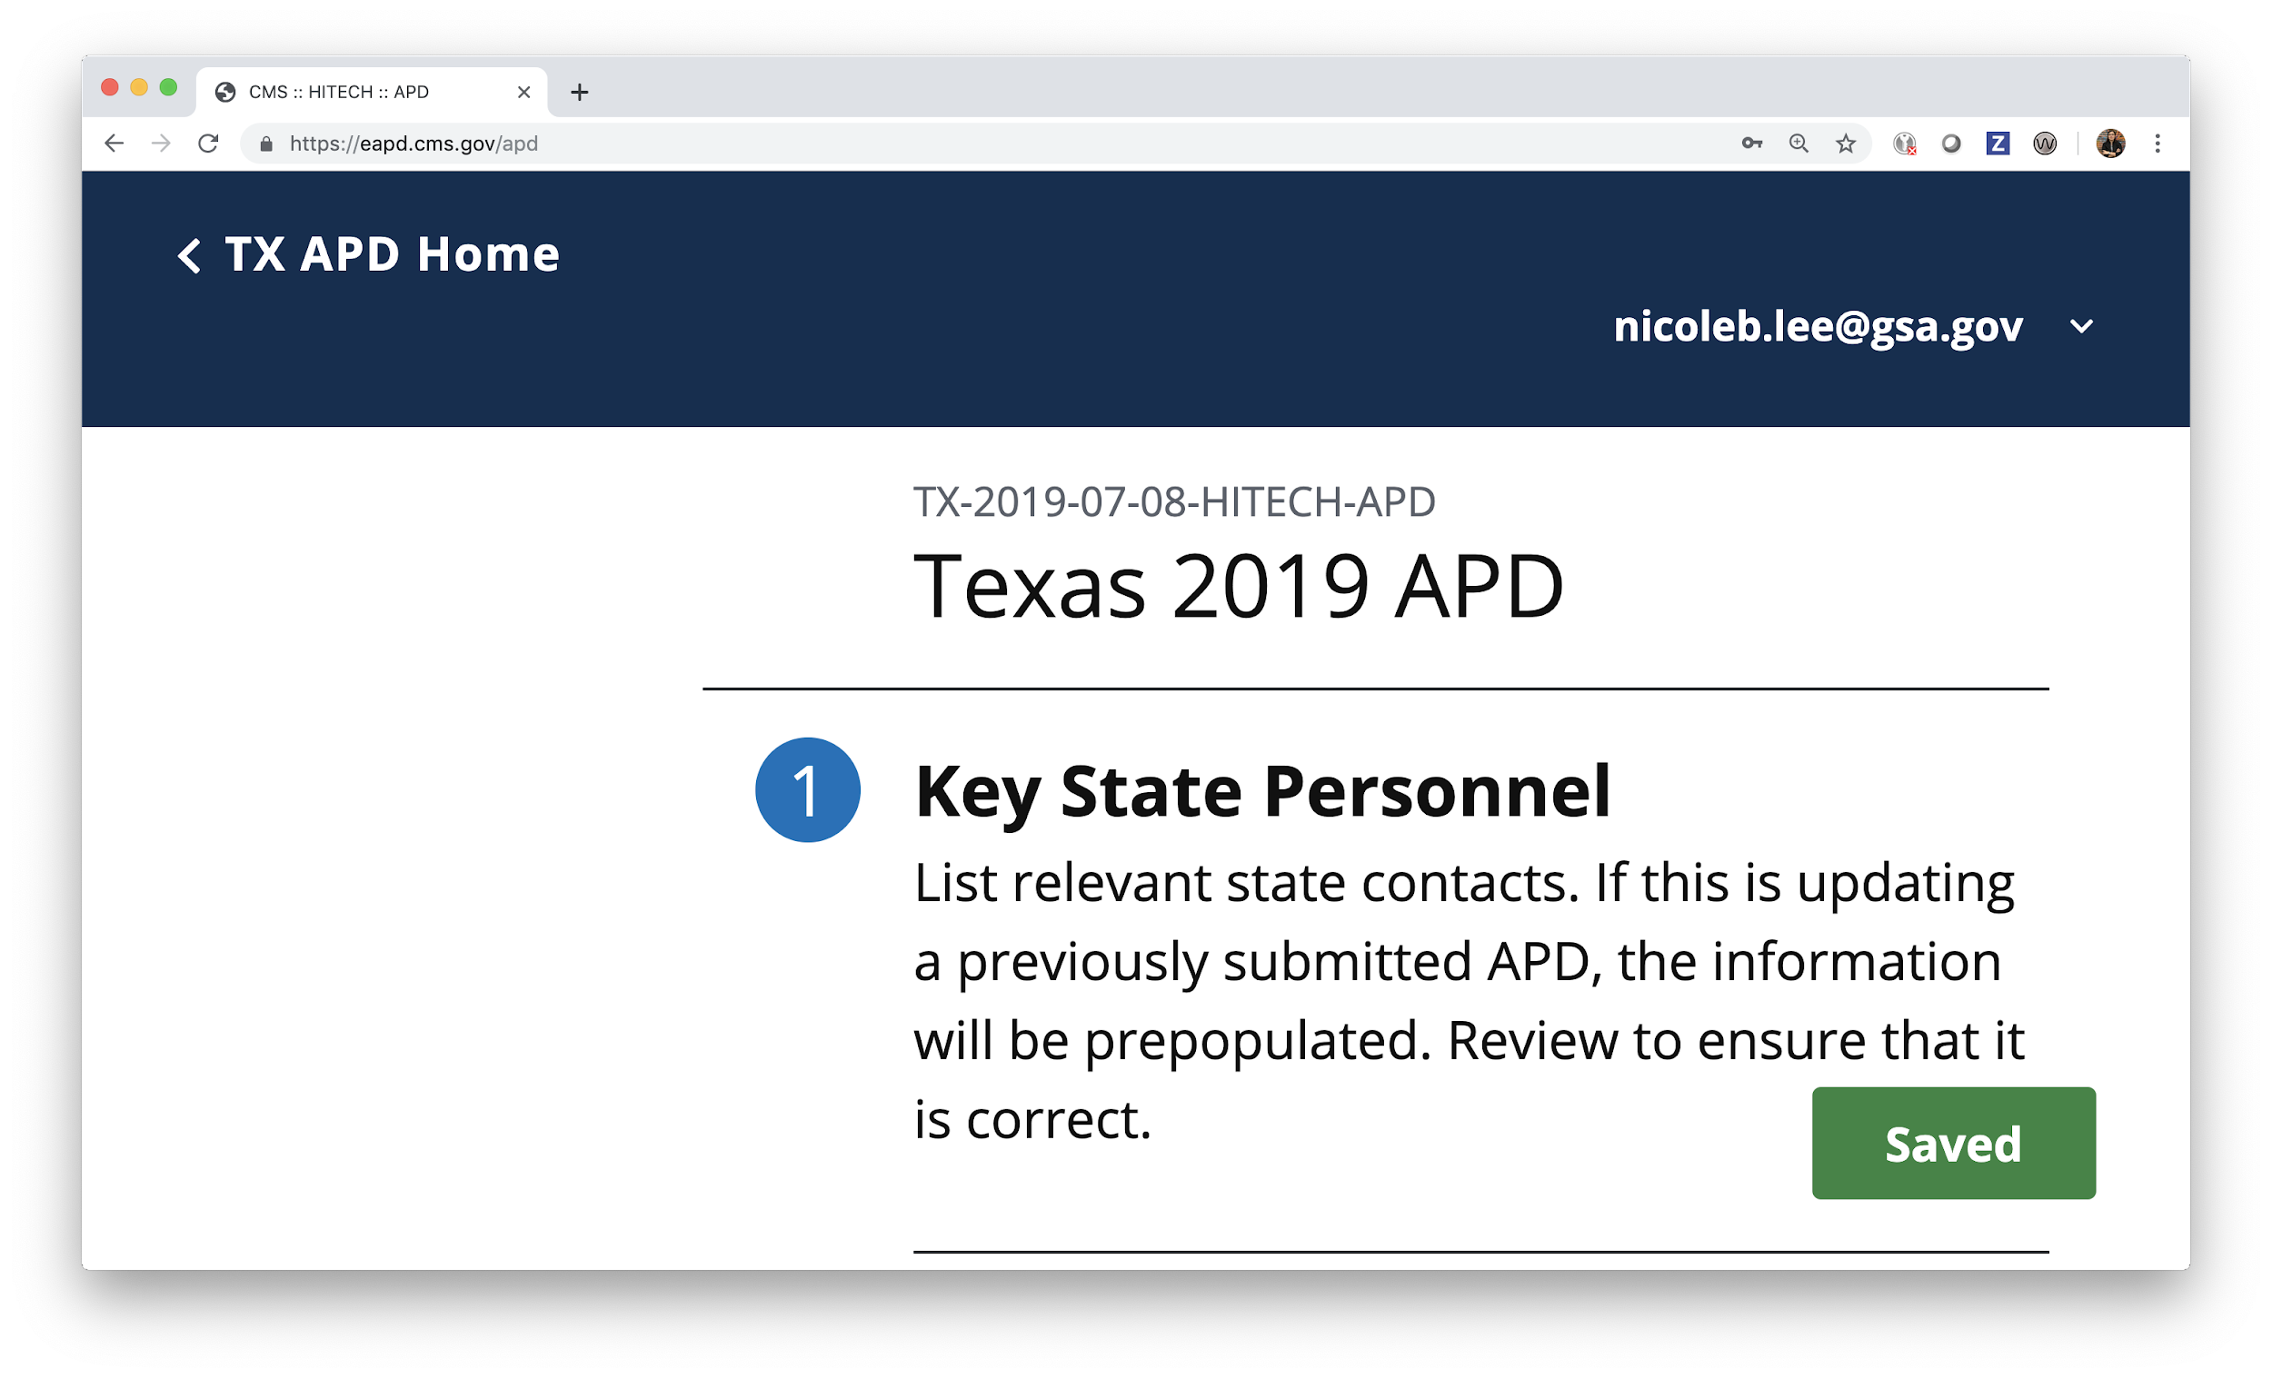
Zooming in causes key navigation content to disappear
100% zoom
200% zoom

Slide 19
How to test
Open a web page and zoom in using your browser’s controls (or cmd +) until you get to 200% zoom. All of the content should reflow appropriately. Then test it again at 400% zoom. (You can reset your zoom back to 100% with cmd 0)
If anything breaks, you can reference WCAG 1.4.4 Resize Text and/or WCAG 1.4.10 Reflow.

Slide 20
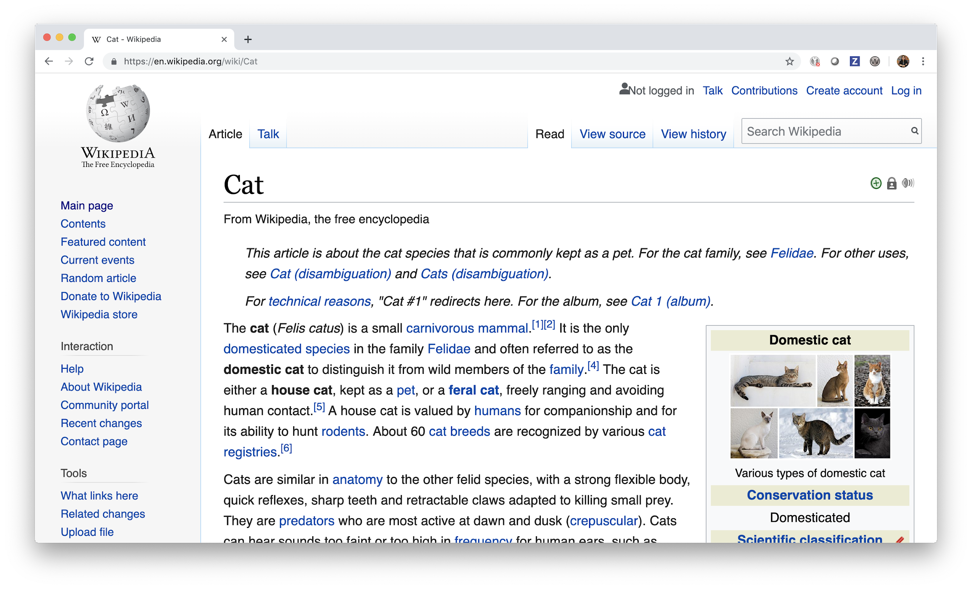
Increasing text size makes all text larger, but does not break the page
Medium text
Large text

Slide 21
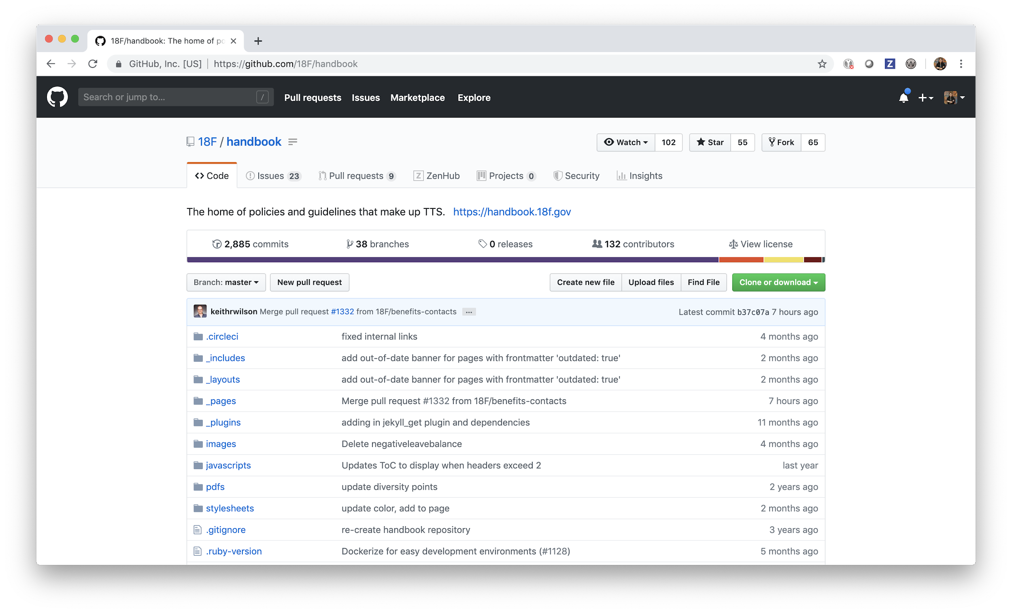
Increasing text size… does nothing
Medium text
Huge text

Slide 22
How to test
Go into your browser settings and increase the default font size. Then open the web page you are testing.
The text should resize accordingly, and the page should reflow to accommodate the larger text without scrolling both horizontally and vertically. Scrolling vertically by itself is not a problem.
If anything breaks, you can reference WCAG 1.4.4 Resize Text and/or WCAG 1.4.10 Reflow.

Slide 23
3 / Turn on your screen reader! Make sure all functionality still works.
Notes:
Nikki

Slide 24
For many of us, using a screen reader is really intimidating.

Slide 25
We’re going to do it anyway! After an hour or two, you’ll be comfortably navigating websites.

Slide 26
Screen reader support is easy to get wrong, and it makes far too many websites completely unusable for people. The only way to make sure it’s working is to test it.

Slide 27
Demo
Notes:
Robert

Slide 28
How to test
Turn on your screen reader and try to understand the content of the page using your screen reader and keyboard. Try to refrain from using your mouse. It’s ok to compare what you hear to what you see — it’s a helpful way to spot when screen reader support breaks down.
You should be able to do everything on the page with just your screen reader and keyboard—here are how to do the basics.
There are a lot of parts of WCAG related to screen reader support; focus on describing the problem you found over citing specific criteria.

Slide 29
Questions?

Slide 30
Homework
Notes:
Nikki

Slide 31
Assignment #3:
We have two tasks for you — spend about 20 minutes on each one.
Turn on VoiceOver (command + f5), and follow the built in tutorial.
Now take a look at this web page. Use only your screen reader and keyboard to read the entire page and then write 1-2 paragraphs about your experience.

Slide 32
Thanks!
Slack #g-accessibility

